Slide 1
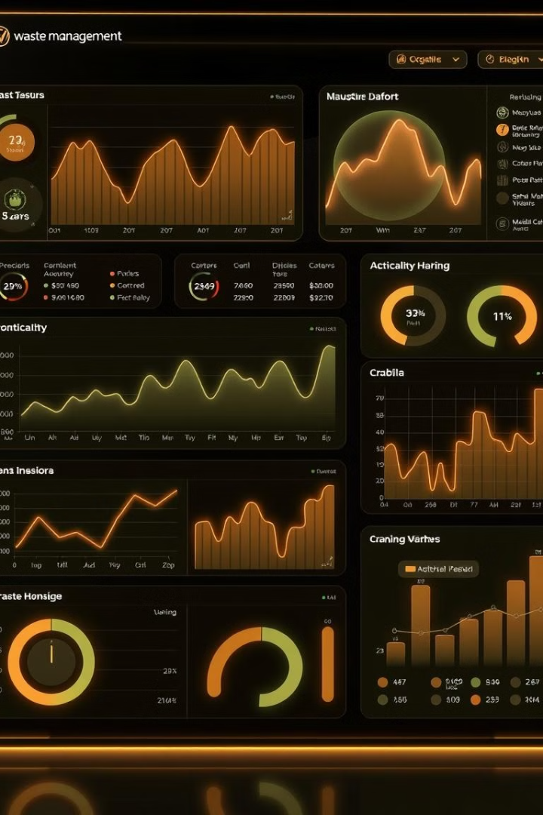
EcoWaste - Waste Management Dashboard
EcoWaste is a web-based dashboard for tracking and managing waste collection. It provides a user-friendly interface built with HTML, Tailwind CSS, and JavaScript.

Slide 2
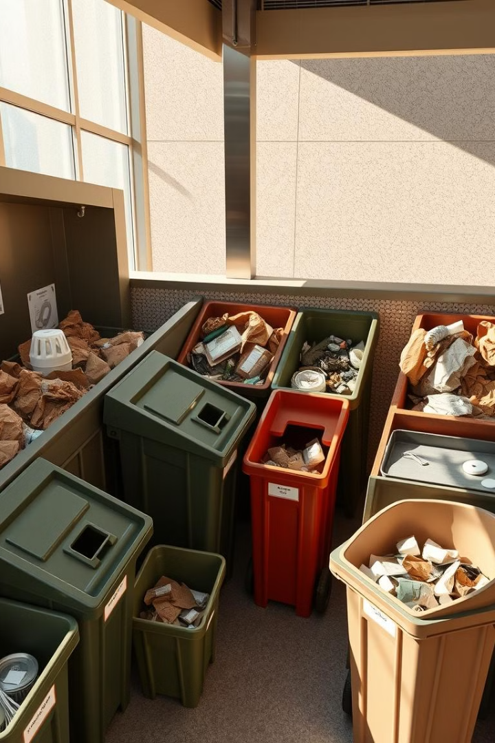



Key Features Overview
Dashboard Metrics
Collection Management
Real-Time Activity
Summary metrics like total waste collected and active bins.
Form for adding new waste entries with ease.
Collection activity table updated in real-time.

Slide 3

Waste Category Support
Plastic
Paper
Dedicated tracking for plastic waste.
Manage and monitor paper waste efficiently.
Metal
Organic
Track metal waste collection and recycling.
Handle organic waste streams effectively.

Slide 4
Technical Implementation Highlights
Frontend-Only Approach
Tailwind CSS
Vanilla JavaScript
Simple design for ease of deployment.
Clean styling for consistent UI elements.
Lightweight interactivity without frameworks.

Slide 5
Current Status and Future Roadmap
1
Functional UI
Basic interactive elements are implemented.
2
User Authentication
Adding secure user access control.
3
Data Persistence
Implementing backend database integration.
4
Analytics Charts
Visualizing waste trends and patterns.

Slide 6

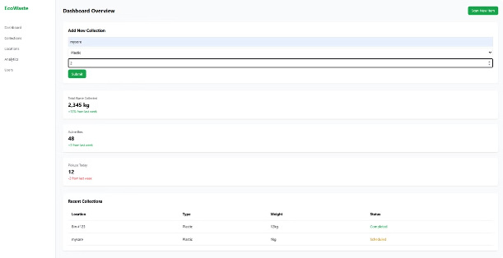



User-Friendly Interface
Sidebar Navigation
Metrics Cards
Dynamic Table
Easy access to dashboard sections.
Clear display of key performance data.
Real-time updates for new collections.

Slide 7




Target Organizations
1
Efficiency
2
Monitoring
3
Centralized Platform
4
Environmental Impact
EcoWaste is designed for waste management organizations looking to digitize operations. The goal is to monitor collection efficiency and environmental impact using a centralized platform. The platform can streamline collection management.

Slide 8

Key Takeaways
1
Centralized Platform
2
Actionable Insights
Monitor waste collection efficiently.
Data-driven decisions for improvement.
3
Digitized Operations
Modernize waste management processes.

